Slide 1
History Taking
Marissa Drake, CNP, DNP, FNP​​
Community Faculty​​
College of Nursing and Health Sciences​​
Metropolitan State University​​
St. Paul, MN
Some content adopted with permission from Dr. Kim Young Pfuhl

Slide 2
Agenda
Types of visits
SOAP note and documentation of the history
Subjective v. objective data
HPI
Approach to collecting the history
OLDCARTS
Timeline
Interval history
Preventative history
ROS

Slide 3
History taking is an art
It takes practice, jump in as soon as possible in clinicals
½ - 1 shadow day, then start doing histories
It is normal to feel uncomfortable and awkward as you practice this new skill, this is a sign of growth
Knowing your patient and developing a relationship over time lends to the history taking process
Eventually you build an expansive context around the patient as you begin to understand their health beliefs, support structure, values, etc.
This is one of the most rewarding aspects of primary care

Slide 4
Three kinds of visits in primary care
New v. established patient
More comprehensive history for a new patient
Acute/problem focused visit
Follow up or chronic disease management visit
Routine follow up
Hospital follow up
3. Preventative visit
Adult health maintenance
Well child check
Sports physical
Pre-Op
The history you collect will depend on the type of visit it is

Slide 5
Visit type | Approach to the HPI | Documentation Example
Acute visit | OLDCARTS Timeline | Abdominal pain started 1 week ago, it is to the epigastric area. Abdominal pain comes and goes, pt describes as stabbing sensation. Worse after eating, improves with bowel movement. Denies nausea. Does have some diarrhea, 2-3 liquid stools a day. No blood in stools. No fever, chills, body aches. Has tried tums without improvement. Pt has not missed work, has been able to continue in normal activities.
Follow up/ Chronic disease management | Interval history Update today | Interval history: last visit 1 week ago pt’s bp noted to be elevated at 155/86. Lisinopril dose increased from 10mg to 20mg daily and pt advised to f/u in 1 week for recheck Update today: pt has been tolerating increased dose lisinopril without side effects. Not taking bp at home. Reading today 126/78.
Preventative visit | Structured data gathering | Preventative screening – last pap 6/2023. has not started mammograms Family planning- currently has mirena IUD in place, does not desire pregnancy Exercise- walking for 30min 3 days a week Social support- reports robust support system with many family members and friends she is close to Self care practices – meditates daily for 10min
Notes:
Overlap between visits

Slide 6
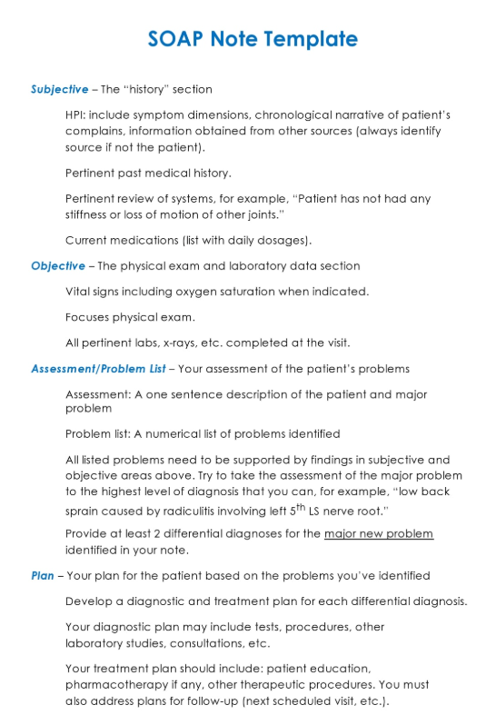
SOAP note
The format of documentation for all clinic visits
S: subjective data
O: objective data
A: assessment – your diagnoses and medical decision making
P: plan – the treatment plan you and the patient decided on
Notes:
In this course focus is on S and O
Look at example SOAP notes on D2L

Slide 7
Subjective data
CC- chief complaint
HPI- history of present illness
Past medical history
Medical diagnoses
Surgery/procedures
Hospitalizations
OBGYN
Allergies
medications
Family history
Personal/social history
Sexual orientation, gender identification, sexual practices
Occupation, education
Health habits (exercise, substance use, diet)
Support system, significant relationships
Safety
ROS- review of systems

Slide 8
Subjective v. Objective Data
Subjective – what the patient is telling you
May also come from family member or direct care giver (especially in geriatric population)
Objective – what the NP and support staff observe
Vitals
Physical exam
Notes:
Document if hx obtained from someone other than the patient

Slide 9
Subjective v. objective
The meaning of these terms differ in healthcare compared to their meaning in research or in everyday life
“Mrs. G is an elderly, overweight white female who is pleasant and cooperative”
Somebody else might not consider her overweight and may not think she is all that pleasant
In a healthcare setting, this is objective data because it is what the clinician is observing about the patient
Age, gender, ethnicity
These things are not always readily observable which would favor the idea of them being subjective data
CMS considers this data objective
Notes:
CMS- centers for medicare and medicaid services

Slide 10
Subjective v. objective
Pain
Pain is defined as whatever the patient says it is whenever the patient says it is occurring
Pain scales?
Usually included in subjective portion
“patient appears uncomfortable” “patient has difficulty getting on exam table” “patient is unable to sit”
Objective reports of pain, what the clinician is observing

Slide 11
HPI Documentation
You do not need to use full sentences
Document succinctly, communicate with as few words as possible, use medical terms
The goal is for another clinician that is reviewing your note to obtain the pertinent data as quickly as possible
Patients have full access to notes now (with few exceptions)

Slide 12
7 attributes of a symptom
O: onset
L: location
D: duration
C: Character
A: aggravating/alleviating factors
R: related symptoms
T: tried treatments
S: severity of symptoms

Slide 13
OLDCARTS
Onset: when did the symptom start
Location: where is the symptom located?
Duration: how long does the symptom last?
Character: what does the symptom feel like (sharp, dull, aching, etc)
Aggravating/alleviating factors: what makes the symptom better or worse?
Related symptoms: what other symptoms are associated with this illness/pertinent ROS
Tried treatment: what have you tried?
Severity: how intense is the symptom

Slide 14
Case Study
Mr. Green is a 45-year-old male, he reports feeling bad for about a week now. He states that he has a runny nose and sometimes has a dry cough and headache. He has felt warm but hasn’t taken his temperature. He denies any nausea/vomiting/diarrhea. He reports a decreased appetite. He has been around people at work that have had the flu recently. No home treatment has been done. These symptoms have been constant, and all day/night are worsening the last several days. He rates them as moderate. Nothing makes it better or worse.
• CC: Cold symptoms/URI • Onset – 1 week • Duration - constant • Location – head, chest • Characteristics – runny nose, dry cough, headache • Aggravating/alleviating factors - nothing • related symptoms- runny nose, dry cough, headache, no GI symptoms • treatment- none tried • Severity - moderate

Slide 15
The timeline history
Can be useful to establish timeline in acute illness- especially when there are multiple symptoms going on
Might be used in conjunction with OLDCARTS
Example: URI
When did it start?
How did it progress?
Is it getting better, worse, or staying the same?
What are the most bothersome symptoms currently?
Symptoms started 3d ago with fever, sore throat, and cough. TMAX 100.2, last fever was yesterday morning. Cough is productive, denies wheezing, shortness or breath, chest pain. Sore throat has now resolved but cough continues to be bothersome. Had chills with fever yesterday, now resolved.

Slide 16
The follow up visit
During chart review, prepare your interval history:
Interval history: Pt here today for f/u of DM2. Last visit 3mo ago A1C 8.6%, pt educated on exercise and diet change and metformin XR increased from 500mg daily to 1,000mg BID. Advised f/u in 3mo.
Update today: pt reports home glucose readings have been 70-80s in the morning, no readings above 200. Tolerating increased dose metformin, no diarrhea. Notes he has lost 5lb, started walking 30min daily. A1C today 7.1%.

Slide 17
ROS- review of systems
Subjective data from the patient, not your exam
Document as ‘positive for’ or ‘negative for’
Constitutional- negative for fever, chills, weight loss
HEENT- negative for vision changes, ear pain, rhinitis, throat pain
Resp- POSITIVE for cough. negative for wheezing, or shortness of breath
CV- negative for chest pain, palpitations, presyncope
Breast- negative for breast tenderness
Abdomen- POSITIVE for intermittent constipation. Negative for abdominal pain, nausea, or diarrhea
GU- negative for dysuria or vaginal discharge
MSK- negative for joint or muscle pain
Neuro- POSITIVE for intermittent headaches. Negative for vision changes or paresthesias
Skin- negative for rash
Psych- negative for mood changes

Slide 18
ROS
Comprehensive (physical, preop) v. focused (acute or f/u visit)
You will not review every system at every visit, only what is pertinent to the visit
Only document information you have obtained
The note is a legal document, you do not want to falsify information
If you did not ask it, don’t document it
You can always make a note in the chart to follow up on it, or call the patient to ask them if it is important

Slide 19
ROS v. HPI
Do not document symptoms twice
Document them in the HPI OR the ROS, not both. Be consistent with your choice
Personally I document positive symptoms in the HPI, I think it helps to tell the story better
‘patient endorses productive cough x 3d. Denies wheezing, shortness or breath, chest pain.

Slide 20
ROS v. HPI subjective documentation
HPI example
HPI: Symptoms started 3d ago with fever, sore throat, and cough. TMAX 100.2, last fever was yesterday morning. Cough is productive, denies wheezing, shortness or breath, chest pain. Denies palpitations or presyncope. Sore throat has now resolved but cough continues to be bothersome. Had chills with fever yesterday, now resolved.
ROS
Const: positive for fever as above
HEENT: positive for sore throat as above.
Resp: positive for cough as above
CV: neg as above
ROS example
HPI: Symptoms started 3d ago with fever, sore throat, and cough. Last fever was yesterday morning. Cough is productive. Sore throat has now resolved but cough continues to be bothersome. Had chills with fever yesterday, now resolved.
ROS:
Const: positive for fever and chills, TMAX 100.2
HEENT: positive for sore throat as above
Resp: Positive for productive cough as above. Negative for wheezing, shortness of breath, or chest pain
CV: negative for chest pain, palpitations, presyncope

Slide 21
Health History Activity (30min)
Pair up with a partner, one will be the provider and one will be the patient
Provider: practice taking a HPI from patient using OLDCARTS approach
Select the relevant systems to review, and perform a review of systems
Document your HPI and ROS on your laptop or on paper
Patient: do not volunteer information unless it is elicited. makeup information if it is not provided
Switch roles
Instructors will circulate and give feedback

Slide 22
Other D2L Content this Week
Comprehensive health history
Approach to the clinical encounter
SOAP Notes
ROS
Peds Health History

Slide 23
Assignments 1-4 Review
7 attributes of a system
Subjective/Objective Data
ROS (quiz)
Health History

Slide 24
References
Bickley, L. S. (2023). Bates’ Guide to Physical Examination and History Taking (13th ed.). Philadelphia: Wolters Kluwers.

